Slide 1
openSUSE 12.2
Note for presenter:
- check the 'notes' for each slide
- and remove this note!
By x
openSUSE Ambassador

Slide 2
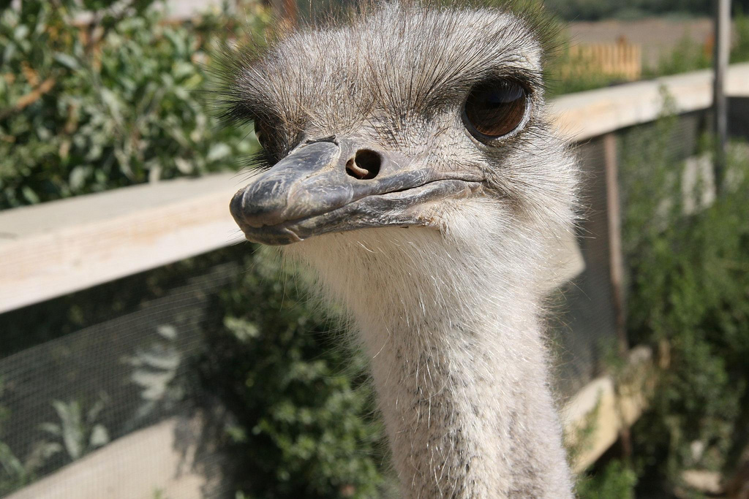
Hi there!
Notes:
Hi there!
My name is XXX (talk a little about yourself)

Slide 3
Agenda
General introduction to openSUSE
Introducing openSUSE 12.2
  Faster
  Evolved
  Polished and new
Ecosystem
  Tumbleweed
  Studio, OBS, ...
Why we rock!
Where to get it
Notes:
Let's talk agenda.
I will start talking about what openSUSE IS and then point out the main features of the new release.
After that, I'll talk shortly about a few other things around the openSUSE release and you'll get time for questions at the end. (or: whenever you have one)

Slide 4
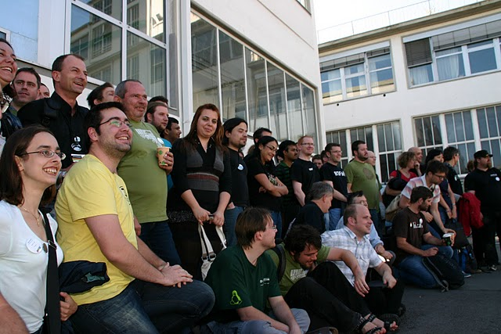
Welcome to openSUSE!
Fun: open minded, collaborative and not bureaucratic
One of the top-three linux distributions (and the coolest)
All in one linux: desktop, laptop, server, virtual, cloud
Focus on stability and getting-work-done environment
Notes:
OpenSUSE is only a few years young but it is building on the 16 years experience of SUSE Linux.
We are a very open project, seeking collaboration with other projects and not bogging down our own development processes with committees, rules and steering groups everywhere.
What makes openSUSE Linux special is the focus on choice and flexibility.
We ship KDE, GNOME, XFCE and LXDE and our configuration tool YaST helps you to configure even complicated things like Virtual Machines and mail servers.
openSUSE is also a little more conservative than the other big distributions, taking 2 extra months to develop a stable product. We want you to get work done!
But thanks to the Open Build Service, nowhere will you find such fresh software as for openSUSE.

Slide 5
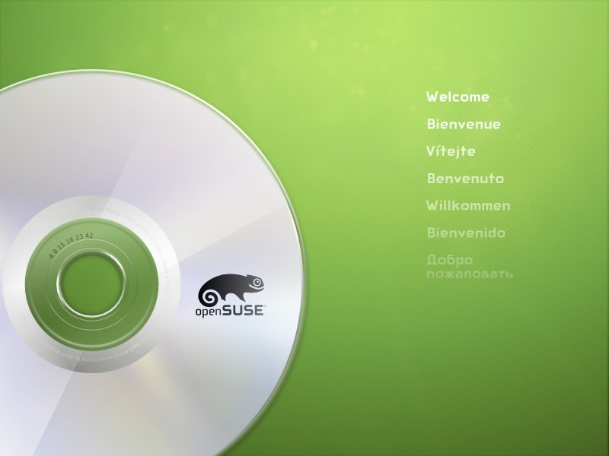
Notes:
On november 5 2012 openSUSE 12.2 was released after a delay of 2 months of extra stabilization.
This release introduces many cool new features and today I will give a short overview of what's new.

Slide 6

Faster
Faster booting
  Systemd 44
  Plymouth = pretty
  GRUB2
Faster running
  Kernel 3.4 is better with data transfers
  Glibc 2.15 and GCC 4.7 speed up most applications
  Qt 4.8.1 makes your desktop responsive
  Dolphin shows files quicker, GNOME scrolls smoother.
Notes:
First of all, 12.2 is about speed, speed, speed.
We worked hard to make openSUSE 12.2 really, really fast. And the result is a noticeable change: pretty much every reviewer comments on how fast openSUSE 12.2 is!
The improvements are everywhere: from really deep under the hood like the kernel and the g-lib-c library until the applications.
You get a butter-smooth desktop experience out of openSUSE 12.2 and doesn't that make using your computer a lot nicer? Of course, we also made it prettier: we now use Plymouth for a bootup splash, looking real nice!

Slide 7
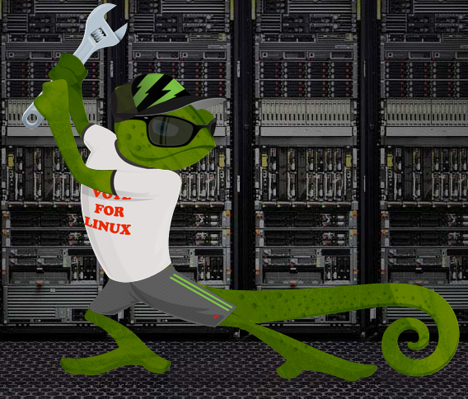
Evolved
Grub2
  LVM
  Btrfs
  UEFI Secure boot
Simplifying Unix hierarchy
LLVM for 3D
Multi-touch in Xorg 1.12
Notes:
Second, we wked on getting the latest mature Linux technology in your hands.
This openSUSE release has better support for the new and upcoming btrfs ('butterFS') filesystem. You can use it as boot partition (we now also support LVM managed boot partitions, btw) and we improved error handling and stability as well as the integration in openSUSE with snapper. Snapper lets you create and manage filesystem snapshots, a main feature of btrfs.
We also support the new UEFI secure boot – so you can boot from new Windows 8 hardware.
We're also doing some plumbing in openSUSE to improve compatibility with other Linux systems. This makes collaboration easier and we consider that a very important goal: it is what makes us different from the proprietary OS'es.

Slide 8

Polished and new
Latest desktops
  Faster, better, smoother!
Firefox, LibreOffice etc
Gimp, Krita, Inkscape
Amarok, Tomahawk
Wine, Spice & GNUCash
Notes:
The last major area of improvements is something you, as end user will notice: we worked hard on polishing how openSUSE feels. We updated to newer software where it made sense, picking stable and well tested over bleeding edge.
Also, we introduced new things. Let's go over a few specifics now.

Slide 9
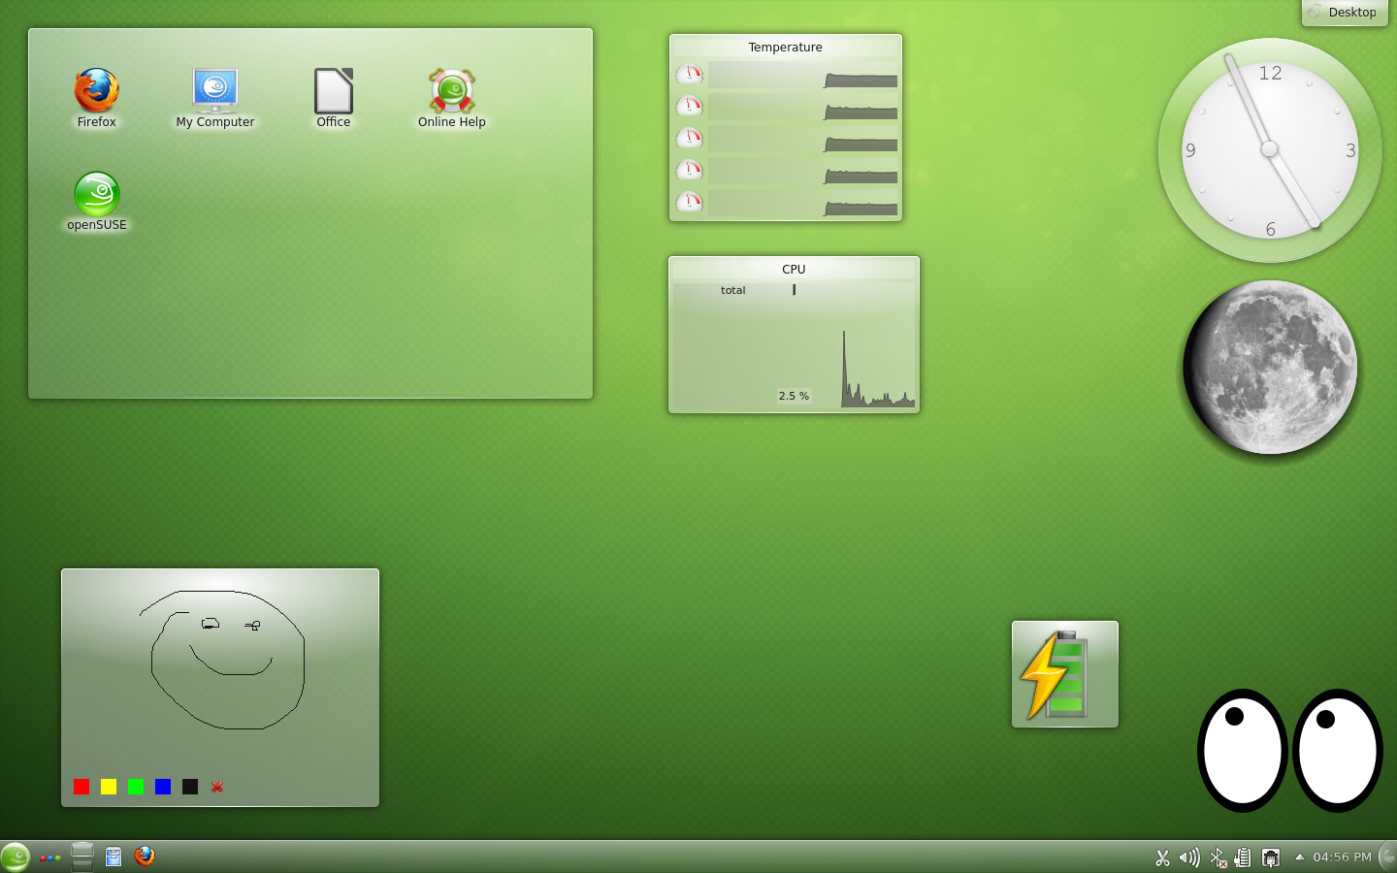
Plasma Desktop
Notes:
Plasma Desktop from KDE is the default desktop in openSUSE. It offers a quite traditional but very flexible desktop.
It is not only a lot faster in openSUSE 12.2 but also has easier power management and better document and image handling. The filemanager, Dolphin, is way smoother in handling lots of files and the email, calendar and news applications are much faster and more stable.
Developers will enjoy improvements to the text editor's search and replace functions, vi mode, and a faster translation tool with support for more file formats.

Slide 10
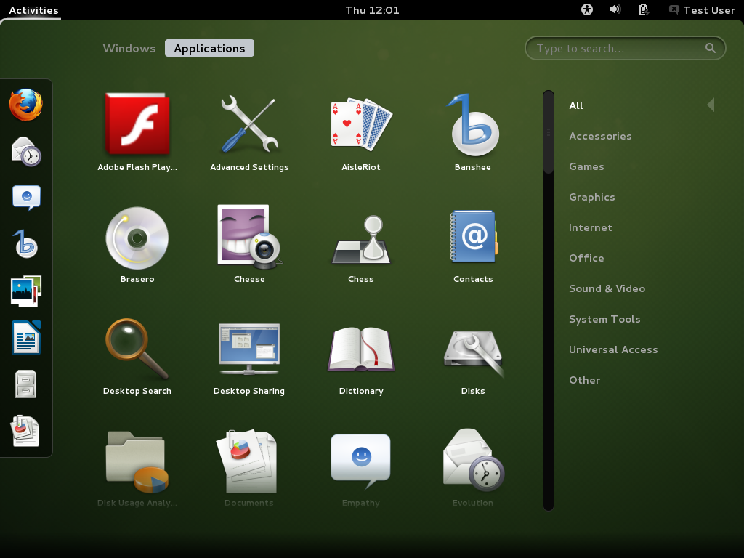
GNOME Shell
Notes:
With GNOME Shell, the GNOME community has developed a new and easy way of interacting with your computer, ready for future touch interfaces.
As openSUSE's second most used and official desktop, we put much effort in this release. GNOME Shell 3.4 introduces 'Web', an polished version of Epiphany, the GNOME web browser. In the communication area there is now support for video calling, Facebook and Windows Live Messenger chat in Empathy.
Gnome Shell now shows application menus from the main title bar, and includes integrated document search functions from the overview. OpenSUSE automatically enables tap-to-click and disables the touchpad while typing on laptops.

Slide 11
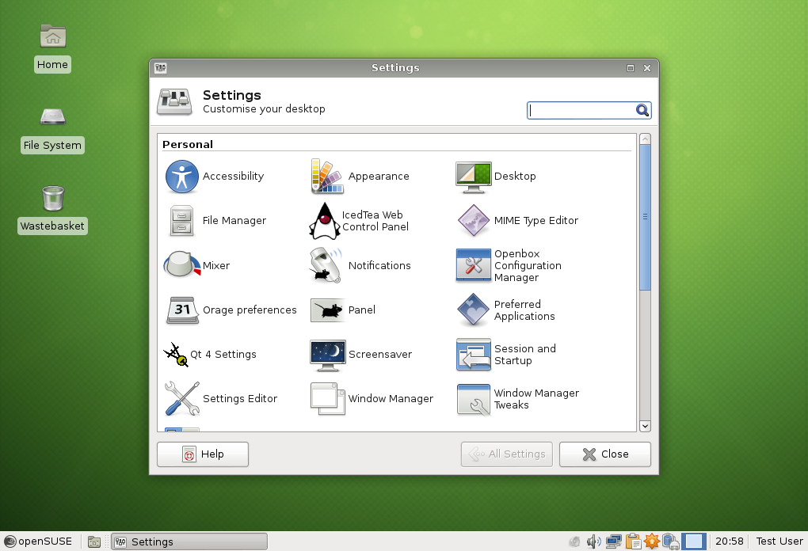
XFCE, LXDE and more
Notes:
Rising quickly in popularity and contending for Linux' second most popular desktop, XFCE brings a 'deskbar' mode to its panels, allowing you to have a sidebar with horizontal widgets on your screen or to maximize screen estate usage on wide screens.
The Application finder has been rewritten and now replaces the “Run Program” dailog and a new MIME type editor is introduced. Last but not least, the window manager now supports basic Tiling!
LXDE, the lightweight alternative, introduces an updated panel with new widgets as well as bugfixes and theming improvements.
KDE 3 has received some updates to work better on modern Linux systems with Udisks2 and Upower backends.
Last but not least, there were desktop-independent internationalization improvements, esp for Chinese, Japanese and Korean languages..

Slide 12
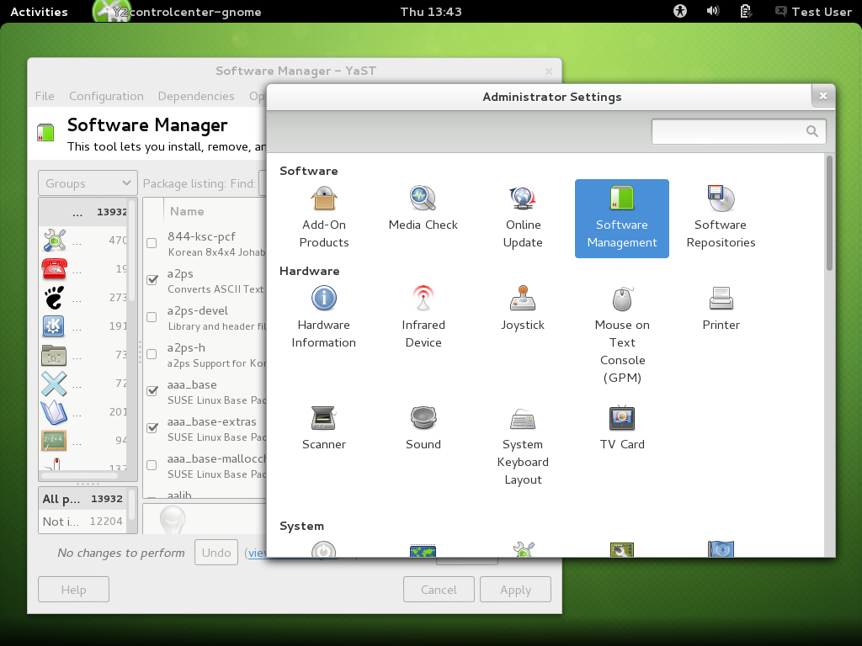
What else is new?
  Scientific tools
    Bring math applications such as numeric computation, plotting, and visualization
  Stellarium astronomical simulator
    Explore the night sky without a telescope.
  1.0.2 of Google's Go language
  Latest C++ language support
    Implemented in GCC 4.7.1 and Qt Creator 2.5.
  Suite of Digital Forensics/Incident Response tools
Notes:
Aside from the major desktop changes, this openSUSE release brings of course the latest browsers (Firefox, Chromium, reKonq and more) and LibreOffice, Inkscape, the GIMP, Krita for your office and creative needs.
New is a set of heavyweight scientific tools which brings math applications such as numeric computation, plotting, and visualization to openSUSE. Then there is the Stellarium astronomical simulator which lets you explore
the night sky without a telescope. Programmers will enjoy version 1.0.2 of Google's Go language, as well as the latest C++ language standards implemented in GCC 4.7.1 and Qt Creator 2.5.
For sysadmins, openSUSE 12.2 ships a new set of digital forensic and incident response tools.

Slide 13


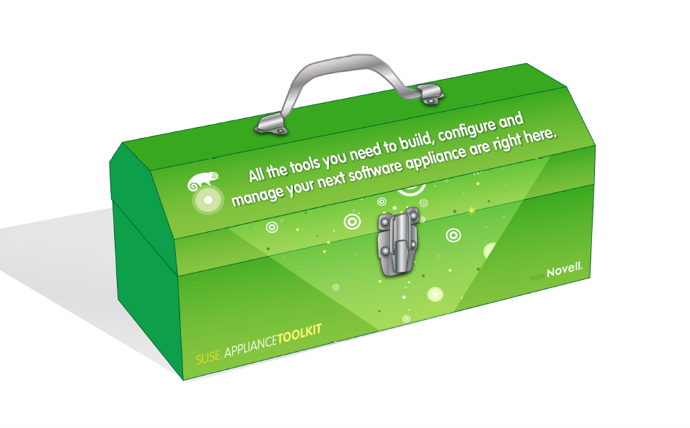
Tumbleweed
  Escape the upgrade mill!
Open Build Service
  ~200,000 packages, ~40,000 packagers, >20 distro's
Packman multimedia repos
  You know the silly patent situation
SUSE Studio
  Build your own openSUSE from a browser!
Notes:
openSUSE does more than make a distribution.
We offer the 'tumbleweed' repo, a rolling-release repository with the latest software. No more upgrading to a newer version of your distribution – tumbleweed means you already use it! If you already use Tumbleweed, you are required to make a final change to your repositories. Check opensuse.org/tumbleweed for more information.
We also develop the Open Build Service, a cross-distribution, cross-platform package build tool. It is free to use on build.opensuse.org and over 30.000 people use it to package for distros like Ubuntu, Fedora and of course openSUSE.
Packman offers the multimedia packages which we can't ship due to the silly patent laws.
Finally, if you want to build your own Linux OS from a web browser – you need to check out susestudio.com ;-)

Slide 14

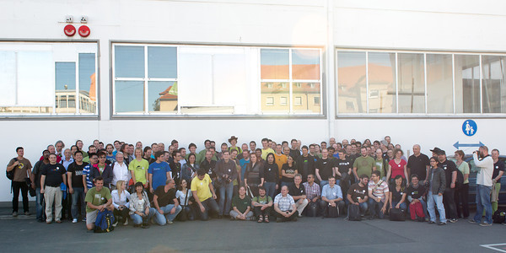
Notes:
But the coolest thing about openSUSE are our people. We have the most open, fun-loving and creative distribution team out there!

Slide 15
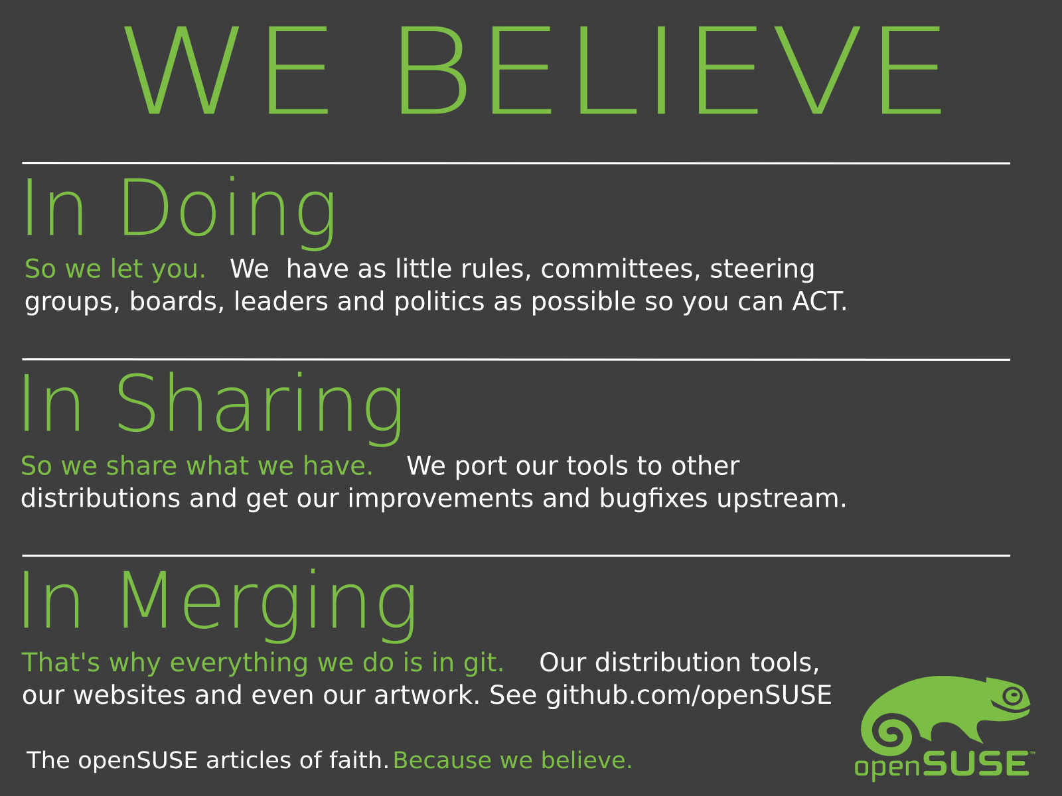
Notes:
We strongly believe in the principles of Doing, Sharing and Merging and through that, we're the distribution where EVERYBODY CAN MAKE A DIFFERENCE!
If you want to learn more, check our website or talk to me later.

Slide 16
Get openSUSE 12.2 on:
http://opensuse.org/download
Notes:
To get openSUSE, go to openSUSE.org. You will find download links and more.
To build your own OS on top of openSUSE, go to susestudio.com – you can customize it with your packages, artwork and even files and scripts, then download it for an USB stick, hard drive or CD.
Of course you can look up an openSUSE ambassador like me and see if they have some DVD's of openSUSE for you!

Slide 17
Have a lot of fun!
Notes:
Thanks for listening!

